Slide 1
DESIGN AND ANALYSIS OF ALGORITHMS
SUBMITTED BY: VARTIKA CHATURVEDI
ROLL NO.:181210056
SUBMITTED TO: DR. CHANDRESH KUMAR MAURYA

Slide 2
DAY -1
Elementary Graph Algorithms

Slide 3
Graph Representation
Given a graph G = (V, E)
The graph may be directed or undirected
There are two common ways to represent graphs for algorithms:
Adjacency lists.
Adjacency matrix.

Slide 4
Running Time
We will be talking about the running time of graph algorithms in terms of both Vertices
|V| and Edges |E|
We can remove the cardinality when in asymptotic notation
o Example: O(V + E)

Slide 5
Adjacency Lists
Array Adj of |V| lists, one per vertex
Vertex u’s list has all vertices v such that
(u, v) ∈ E
Example:
1 2
3
5
4

Slide 6
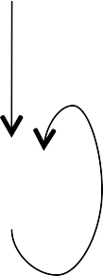
Adjacency Matrix
|V| x |V| matrix A = (a_{ij})
1
if (i, j) ∈ E
ªij
=
0
otherwise
1
2
1
2
3
5
4
3
4

Slide 7
Breadth-First Search
Input: Graph G = (V, E), either directed or undirected, and source vertex s is in V.
Output:
d[v] = distance (smallest # of edges) from s to v, for all v in V.
π[v] = u such that (u,v) is last edge on shortest path s->v
u is v’ ‘s predecessor
Set of edges {(π[v],v): v ≠ s} forms a tree

Slide 8
Breadth-First Search
Idea: Send a wave out from s.
First hits all vertices 1 edge from s.
From there, hits all vertices 2 edges from s.
Etc.
Use FIFO queue Q to maintain wavefront.
v is in Q if and only if wave has hit v but has not come out of v yet

Slide 9
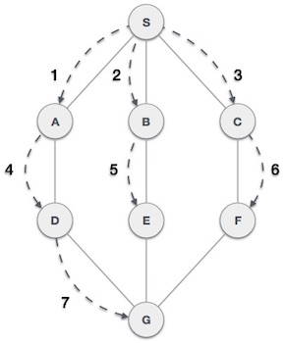
BFS Example
The BFS algorithm traverses from S to A to B to C to D to E to F to G.

Slide 10
Depth-First Search
Input: G = (V, E), directed or undirected. No source vertex given.
Output: 2 timestamps on each vertex:
d[v] = discovery time
f[v] = finishing time
π[v] = u such that (u,v) is last edge on shortest path s->v

Slide 11
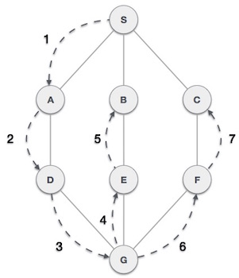
DFS Example
The DFS algorithm traverses from S to A to D to G to E to B to F to C.

Slide 12
DAY- 2
Minimum Spanning Tree, Kruskal’s Algorithms, Prim’s Algorithms

Slide 13
MINIMUM SPANNING TREE
A minimum spanning tree (MST) or minimum weight spanning tree is a subset of the edges of a connected, edge-weighted undirected graph that connects all the vertices together, without any cycles and with the minimum possible total edge weight.
A connected, undirected graph
Four of the spanning trees of the graph

Slide 14
MINIMUM SPANNING TREE
A minimum spanning tree has (V – 1) edges where V is the number of vertices in the given graph.
There are mainly two methods used to find minimum spanning out of a connected weighted graph :-
Prim’s algorithm
Kruskal’s algorithm

Slide 15
PRIM’S ALGORITHM
Prim’s algorithm is also a Greedy algorithm.
It starts with an empty spanning tree. The idea is to maintain two sets of vertices.
The first set contains the vertices already included in the MST, the other set contains the vertices not yet included.
At every step, it considers all the edges that connect the two sets, and picks the minimum weight edge from these edges.
After picking the edge, it moves the other endpoint of the edge to the set containing MST.

Slide 16
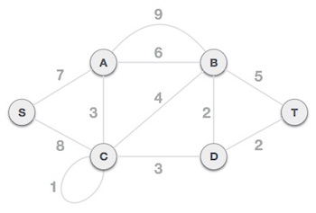
PRIM’S ALGORITHM
Find the MST for the following graph using prims algorithm.

Slide 17
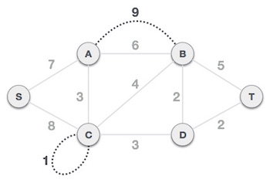
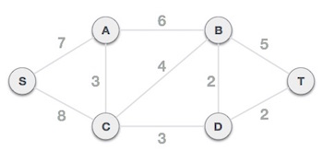
PRIM’S ALGORITHM
Step 1 - Remove all loops and parallel edges

Slide 18
PRIM’S ALGORITHM
Step 2 –
Choose any arbitrary node as root node
In this case, we choose S node as the root node of Prim's spanning tree.
This node is arbitrarily chosen, so any node can be the root node.

Slide 19
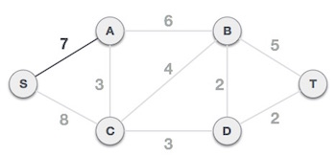
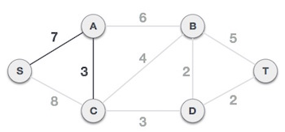
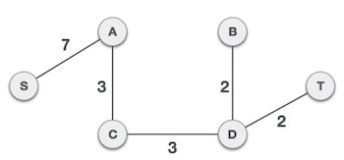
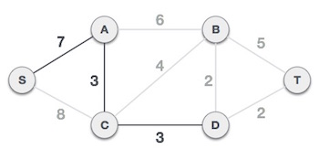
PRIM’S ALGORITHM
Step 3 - Check outgoing edges and select the one with less cost

Slide 20
KRUSKAL’S ALGPRITHM
Kruskal’s algorithm is also a Greedy algorithm.
The Greedy Choice is to pick the smallest weighted edge that does not cause a cycle in the MST constructed.
Let us go through steps for finding MST using Kruskal’s algorithm.

Slide 21
KRUSKAL’S ALGORITHM
Sort all the edges in non-decreasing order of their weight.
Pick the smallest edge. Check if it forms a cycle with the spanning tree formed so far. If cycle is not formed, include this edge. Else, discard it.
Repeat step#2 until there are (V-1) edges in the spanning tree ( MST ).

Slide 22
KRUSKAL’S ALGORITHM
Find the MST for the following graph using Kruskal’s algorithm

Slide 23
KRUSKAL’S ALGORITHM
Step 1 - Remove all loops and Parallel Edges

Slide 24

KRUSKAL’S ALGORITHM
Step 2 - Arrange all edges in their increasing order of weight

Slide 25
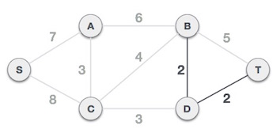
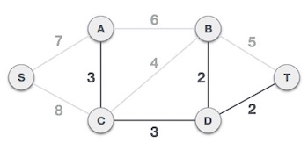
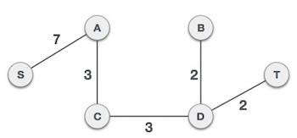
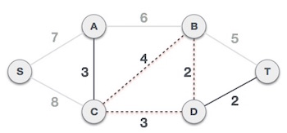
KRUSKAL’S ALGORITHM
Step 3 - Add the edge which has the least weightage

Slide 26
DAY-3
Single-Source Shortest Path, All pair Shortest Path

Slide 27
SINGLE-SOURCE SHORTEST PATH
The single-source shortest path problem, in which we have to find shortest paths from a source vertex v to all other vertices in the graph.
The single-destination shortest path problem, in which we have to find shortest paths from all vertices in the directed graph to a single destination vertex v.

Slide 28
SINGLE SOURCE SHORTEST PATH-DIJKSTRA’S ALGORITHM
We generate a SPT (shortest path tree) with given source as root.
We maintain two sets, one set contains vertices included in shortest path tree, other set includes vertices not yet included in shortest path tree.
At every step of the algorithm, we find a vertex which is in the other set (set of not yet included) and has a minimum distance from the source.

Slide 29
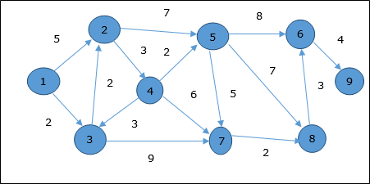
DIJKSTRA’S ALGORITHM
Let us consider vertex 1 and 9 as the start and destination vertex respectively. Initially, all the vertices except the start vertex are marked by ∞ and the start vertex is marked by 0.

Slide 30
DIJKSTRA’S ALGORITHM
Hence, the minimum distance of vertex 9 from vertex 1 is 20. And the path is : 1→ 3→ 7→ 8→ 6→ 9
This path is determined based on predecessor information.
Vertex | Initial | Step1 V₁ | Step2 V₃ | Step3 V₂ | Step4 V₄ | Step5 V₅ | Step6 V₇ | Step7 V₈ | Step8 V₆
1 | 0 | 0 | 0 | 0 | 0 | 0 | 0 | 0 | 0
2 | ∞ | 5 | 4 | 4 | 4 | 4 | 4 | 4 | 4
3 | ∞ | 2 | 2 | 2 | 2 | 2 | 2 | 2 | 2
4 | ∞ | ∞ | ∞ | 7 | 7 | 7 | 7 | 7 | 7
5 | ∞ | ∞ | ∞ | 11 | 9 | 9 | 9 | 9 | 9
6 | ∞ | ∞ | ∞ | ∞ | ∞ | 17 | 17 | 16 | 16
7 | ∞ | ∞ | 11 | 11 | 11 | 11 | 11 | 11 | 11
8 | ∞ | ∞ | ∞ | ∞ | ∞ | 16 | 13 | 13 | 13
9 | ∞ | ∞ | ∞ | ∞ | ∞ | ∞ | ∞ | ∞ | 20

Slide 31
SINGLE SOURCE SHORTEST PATH-BELLMAN FORD ALGORITHM
Dijkstra doesn’t work for Graphs with negative weight edges.
Bellman-Ford works for such graphs. Bellman-Ford is also simpler than Dijkstra and suites well for distributed systems.
But time complexity of Bellman-Ford is O(VE), which is more than Dijkstra.
Negative weight edges might seem useless at first
but they can explain a lot of phenomena like : -
Cash flow
Heat released
Heat absorbed

Slide 32
WORKING OF BELLMAN FORD ALGORITHM
Like other Dynamic Programming Problems, the algorithm calculates shortest paths in a bottom-up manner.
It first calculates the shortest distances which have at-most one edge in the path.
Then, it calculates the shortest paths with at-most 2 edges, and so on.
After the i-th iteration of the outer loop, the shortest paths with at most i edges are calculated.
There can be maximum |V| – 1 edges in any simple path, that is why the outer loop runs |v| – 1 times.
The idea is, assuming that there is no negative weight cycle, if we have calculated shortest paths with at most i edges, then an iteration over all edges guarantees to give shortest path with at-most (i+1) edges

Slide 33
BELLMAN FORD ALGORITHM
Find the shortest path from vertex S all other vertices.

Slide 34
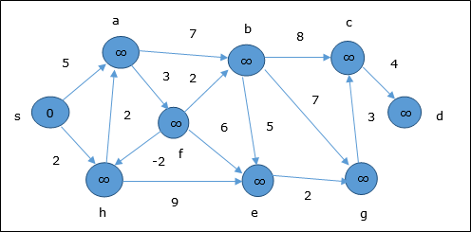
BELLMAN FORD ALGORITHM
STEP -1
At the time of initialization, all the vertices except the source are marked by ∞ and the source is marked by 0.

Slide 35
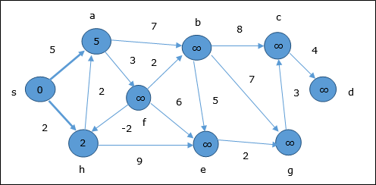
BELLMAN FORD ALGORITHM
STEP-2
In the first step, all the vertices which are reachable from the source are updated by minimum cost. Hence, vertices a and h are updated.

Slide 36
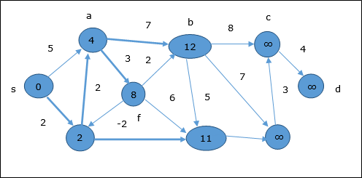
BELLMAN FORD ALGORITHM
STEP-3
In the next step, vertices a, b, f and e are updated.

Slide 37
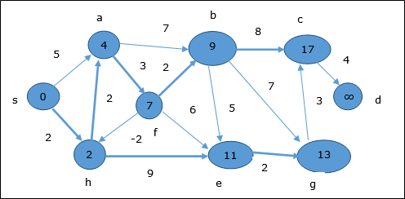
BELLMAN FORD ALGORITHM
STEP-4
Following the same logic, in this step vertices b, f, c and g are updated.

Slide 38
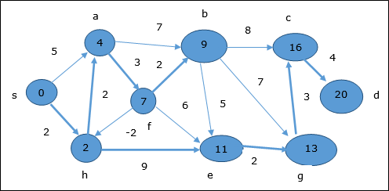
BELLMAN FORD ALGORITHM
STEP-5
Here, vertices c and d are updated.
Hence, the minimum distance between vertex s and vertex d is 20.
Based on the predecessor information, the path is s→ h→ e→ g→ c→ d

Slide 39
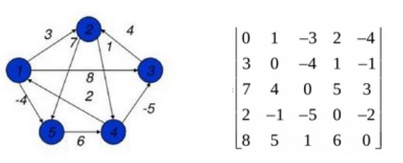
ALL PAIR SHORTEST PATH(FLOYD-WARSHALL’S ALGORITHM)
The all pair shortest path algorithm is also known as Floyd-Warshall algorithm is used to find all pair shortest path problem from a given weighted graph.
As a result of this algorithm, it will generate a matrix, which will represent the minimum distance from any node to all other nodes in the graph.

Slide 40
ALL PAIR SHORTEST PATH(FLOYD-WARSHALL’S ALGORITHM): WORKING
In all pair shortest path, when a weighted graph is represented by its weight matrix W then objective is to find the distance between every pair of nodes.
We will apply dynamic programming to solve the all pairs shortest path.
In all pair shortest path algorithm, we first decomposed the given problem into sub problems.
In this principle of optimally is used for solving the problem.
It means any sub path of shortest path is a shortest path between the end nodes.

Slide 41
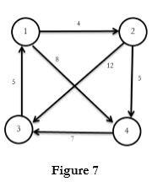
ALL PAIR SHORTEST PATH(FLOYD-WARSHALL’S ALGORITHM)
Compute all pair shortest path for following figure .

Slide 42
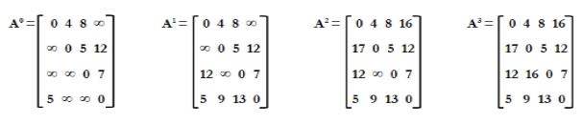
ALL PAIR SHORTEST PATH(FLOYD-WARSHALL’S ALGORITHM)
SOLUTION:

